Slide 2
Kernel mode vs User mode
In Kernel mode
The executing code has complete and unrestricted access to the underlying hardware.
It can execute any CPU instruction and reference any memory address.
Kernel mode is generally reserved for the lowest-level, most trusted functions of the operating system.
In User mode
The executing code has no ability to directly access hardware or reference memory.
Code running in user mode must delegate to system APIs to access hardware or memory.
Most of the code running on your computer will execute in user mode.

Slide 3
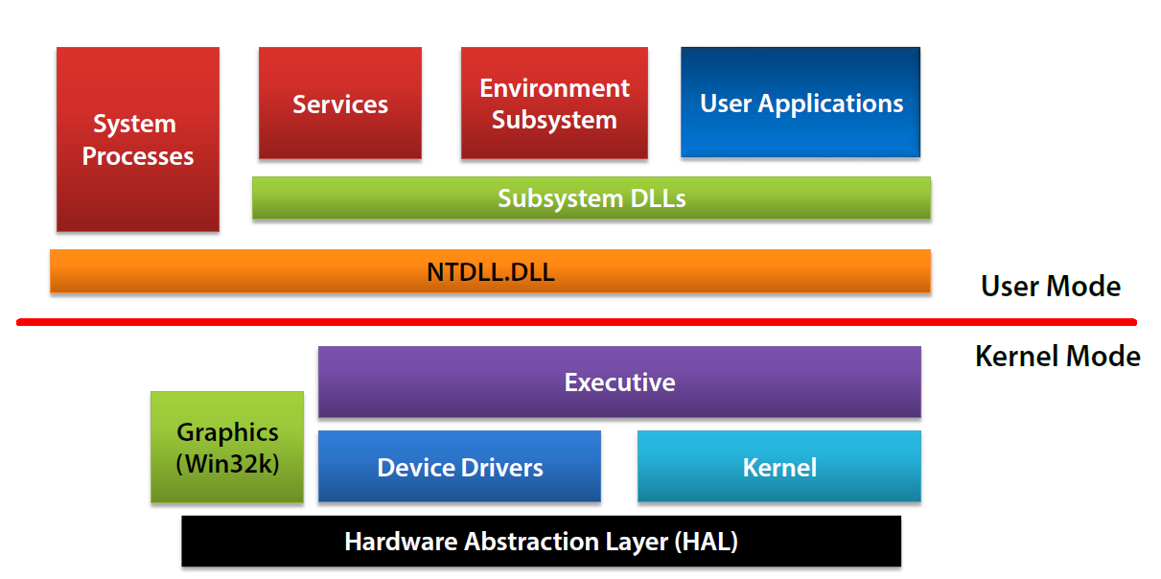

Slide 4
Process
Set of resources to execute a program
Process Consists of:
Private Virtual address space(2GB on 32 bit,8TB in 64 bit)
An executable program
Table of handles to various kernel Object(e.g. File Handle)
Security Context e.g. has some identity
One or more thread that execute code
Optional message queue
Terminate when
One of the threads calls ExitProcess(Win32)
Killed with TerminateProcess(Win32)
Notes:
Demo: Show process Hacker tool(https://processhacker.sourceforge.io/downloads.php)

Slide 5
DEMO – Process Creation

Slide 6
Threads
Entity that is scheduled by kernel to execute code
Contains:
State of CPU registers
Current access mode(User mode or kernel mode)
2 stacks one in user space and another in kernel space
A Private storage area, called thread local storage(TLS)
A priority, used in thread scheduling
Various state :Running ,ready, waiting
Notes:
Talks about worker and UI thread

Slide 7
Thread Internals
How to Create and Start a Thread
Schedules Threads
Thread Priorities

Slide 8
Virtual Memory
Each process “sees” a flat linear memory
Internally ,virtual memory may be mapped to physical memory but may be stored in disk
Processes access memory regardless of where it actually resides
Memory manager handles mapping of virtual -> Physical
Processes can’t (and need not) know actual physical address of a given address in virtual memory

Slide 9
Introduction to windbg
Starting Processes Under WinDBG
Attaching to Processes with WinDBG
WinDBG Commands
Process and Thread internals

